Slide 1

Good morning

Slide 2
Last class
Linear Algebra.
Calculus.
Probability.
Gaussian distribution.
Decision Theory.
Information theory.
Entropy.

Slide 3
Today’s class
Baye’s rule.
Gaussian distribution.
Decision Theory.
Information theory
Entropy
MLE
MAP

Slide 4
Bayes Formula
Suppose the priors P(w_{j}) and conditional densities p(x|w_{j}) are known,
prior
likelihood
posterior
evidence

Slide 5

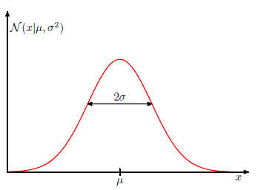

Gaussian Distribution
Normal

Slide 6
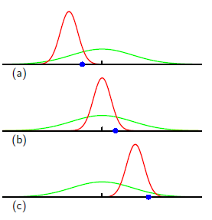
Gaussian Distribution
When we employ the method of maximum
likelihood, we may obtain errors
based on data .
Green is the true Gaussian and
the red ones are based on data in blue.

Slide 7
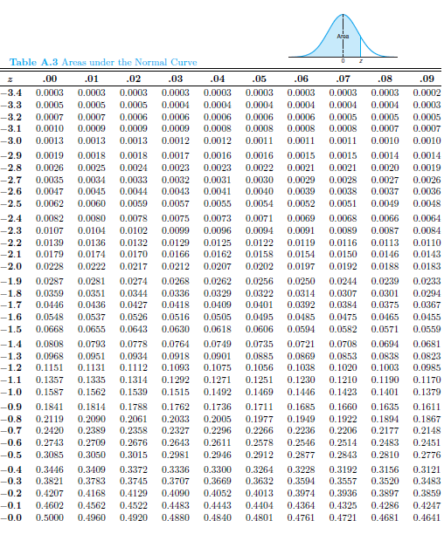
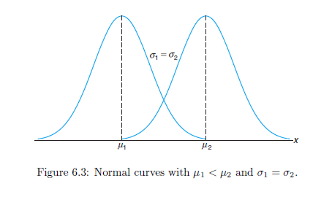
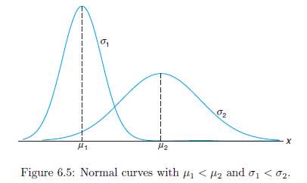
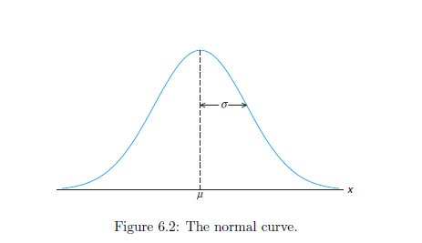
Gaussian Distribution
Gaussian/Normal.

Slide 8
Gaussian Distribution
Ex1: Suppose the diameter of a certain car component follows the normal distribution with X≈ N(10; 3). Find the proportion of these components that have diameter larger than 13.4 mm. Or, if we randomly select one of these components and the probability that its diameter will be larger than 13.4 mm.
Ex2: A bag of cookies is underweight if it weighs less than 500 grams. The filling process dispenses cookies with weight that follows the normal distribution with mean 510 grams and standard deviation 4 grams.
a. What is the probability that a randomly selected bag is underweight?
b. If you randomly select 5 bags, what is the probability that exactly 2 of them will be underweight?

Slide 9
Good morning

Slide 10
Decision theory
Broad types are
Normative and Descriptive:
A normative decision theory is a theory about how decisions should be made, and a descriptive theory is a theory about how decisions are actually made.

Slide 11
Decision theory
A decision should be made such that,
Value of the decision = Expected Utility of making an action A, where the expectation (average) is carried out over the possible outcomes of that action.

Slide 12
Decision theory
Decision process:
1.Identification of the problem
2. Obtaining necessary information
3. Production of possible solutions
4. Evaluation of such solutions
5. Selection of a strategy for performance

Slide 13
Decision theory
Suppose we have an input vector x together with a corresponding vector t of target variables, and our goal is to predict t given a new value for x.
From probability perspective, we are talking about the joint distribution p(x,t).
Determination of p(x, t) from a set of training data is inference.
Taking a specific action based on the predicted/expected values of t form Decision theory.

Slide 14
Good morning

Slide 15
Information theory
The theory studying how information is gathered from known values of random variables is information theory.
If X is a random variable with pmf p(x), then information is the quantity h(x) which is defined by Shannon as
h(x) =-log2p(x).
Low probability events x correspond to high information content.

Slide 16
Information theory
Suppose that a sender wishes to transmit the value of a random variable to a receiver. The average amount of information that they transmit in the process is obtained by taking the expectation with respect to the distribution p(x) and is given by
called the Entropy of the random variable X.
Consider a random variable x having 8 possible states, each of which is equally likely. In order to communicate the value of x to a receiver, we would need to transmit a message whose length is given by the entropy.
H(x)=-8*[1/8]*log2[1/8]= 3 bits.
Hence send it through 3 bits.

Slide 17
Good morning

Slide 18
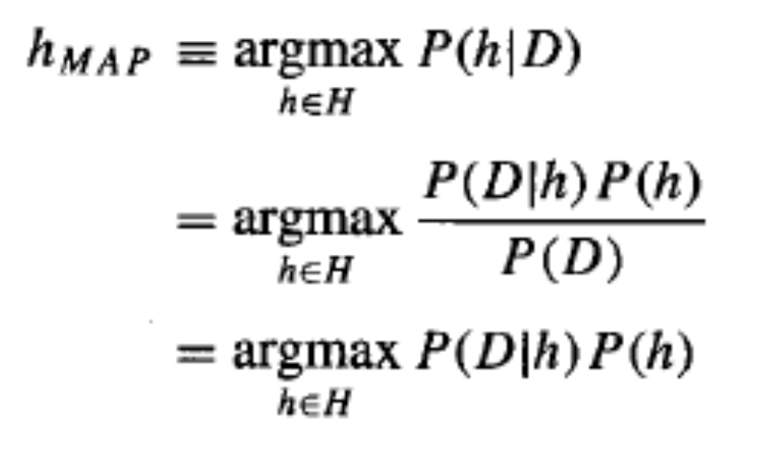
MLE-MAP
The learner considers some set of candidate hypotheses H and it is interested in finding the most probable hypothesis h in H given the observed data D.
Any such maximally probable hypothesis is called a maximum a posteriori (MAP) hypothesis h_{MAP}.
Using Bayes theorem

Slide 19
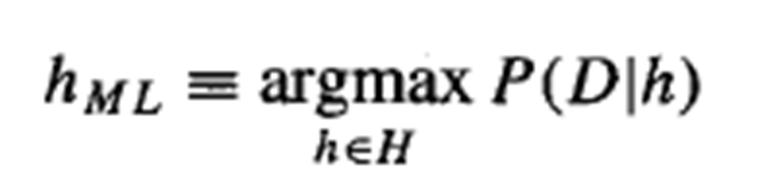
MLE-MAP
Using Bayes theorem

Slide 20
MPE Example
Event | Prior | Posterior
h1 | 0.33 | 0.99107
h2 | 0.33 | 0.0079
h3 | 0.33 | 0
Hypothesis space H;
H={ h1, h2, h3}
h1->multiples of 10;h2->even numbers;h3->odd numbers
Prior p(h)– Assume all hypotheses are equally likely
Likelihood p(D|h)
Algorithm for computing posterior p(h|D)
p(h|D)={ p(D|h)*p(h)} /p(D)
p(h1|Data=X)={1/1000*1/3}/p(X)=[1/3000]/0.000336
=0.99107
Similarly p(h2/X) =0.0079 and p(h3/X)=0
Select hi with higher probability , giving h1 as the hypothesis

Slide 22
MLE
Difference between probability and Likelihood.
Assume we are in Gaussian domain. That is , say, heights of students in this class is normally distributed with mean 160 and SD=25.
Then we say probability of a randomly selected student’s height to be 165 is (from area ideas)=0.20.
On the other hand , if we do not know the exact parameters of the distribution and we have a student’s height is known as 165. Then we’ll ask, what is the Likelihood that it is N(160,25)?

Slide 23
MLE
We can have many normal distributions around the sample and we calculate the likelihood of all. Finally we select the one with the maximum likelihood as the best approximate.
Notationally
Suppose we have x=32. If we assume mean=28 and SD=2, then , the above equation gives L=0.03

Slide 24
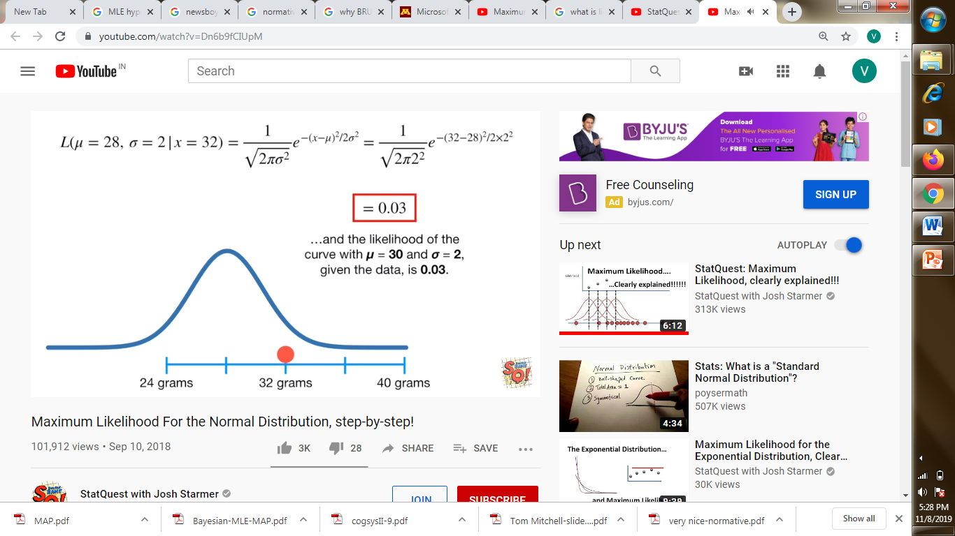
MLE
Suppose we have x=32. If we assume mean=28 and SD=2, then , the above equation gives L=0.03

Slide 25
MLE
Suppose we move it to mean=30 and SD=2, then , the above equation gives L=0.12 which is much better than the earlier one.
We can calculate L for various values of mean , plot it to find the normal like curve , giving the maximum L value and the corresponding parameters are selected as the best.
In the above we varied mean, keeping SD fixed to find ML for mean. Similarly we can do again to find ML of SD by varying it, keeping the mean as fixed.

Slide 26
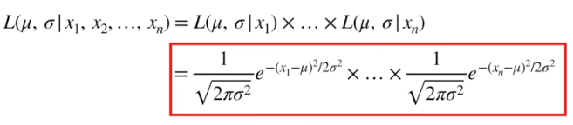
MLE
In the above discussion we had a single sample x=32. If there are two samples assuming indpt, then the Likelihood of the parameters are
L[mean=30,SD=2|x1=32, x2=35]=
L[mean=30,SD=2|x1=32]* L[mean=30,SD=2| x2=35]
Generalizing, we get

Slide 27


MLE
Coming back to our domain of hypotheses, the maximum likelihood hypothesis will be the one which attains maximum value for the product defined . Hence

Slide 28
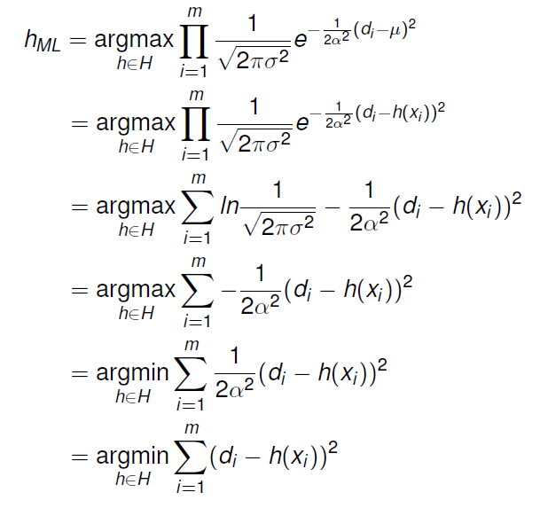
MLE
So,
Since the function on RHS is in product form with many terms, to simplify we take logarithm and fine minimum using first derivative method.

Slide 29
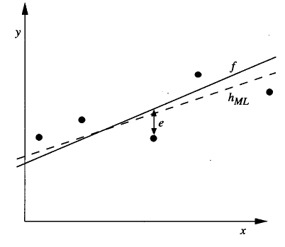
MLE
Consider regression.

